Slide 1
Inheritance
The capability of a class to derive properties and characteristics from another class is called Inheritance.
Sub Class: The class that inherits properties from another class is called Sub class or Derived Class.
Super Class:The class whose properties are inherited by sub class is called Base Class or Super class.
class Animal {
// eat() function
// sleep() function
};
class Dog : public Animal {
// bark() function
};

Slide 3
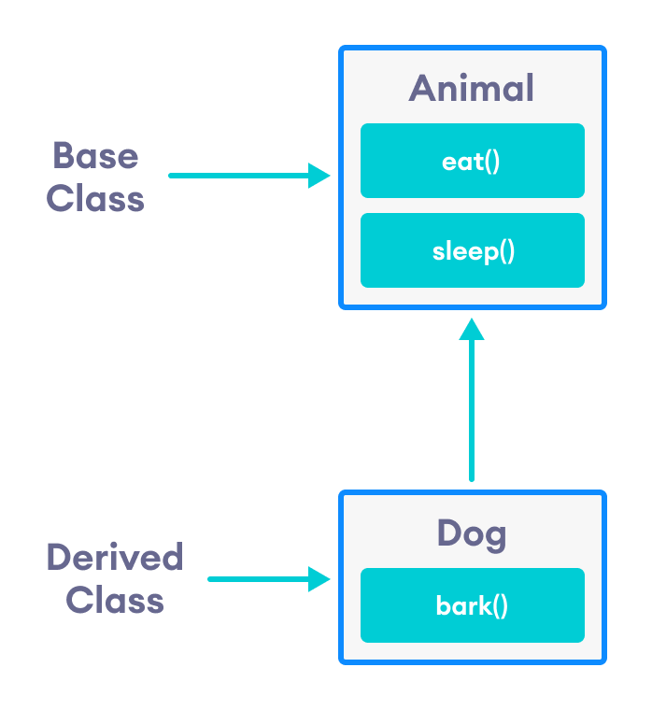

Slide 4

Why and when to use inheritance?
Consider a group of vehicles. You need to create classes for Bus, Car and Truck. The methods fuelAmount(), capacity(), applyBrakes() will be same for all of the three classes.
If we create these classes avoiding inheritance then we have to write all of these functions in each of the three classes as shown in below figure:

Slide 5
Why and when to use inheritance?
You can clearly see that above process results in duplication of same code 3 times.
This increases the chances of error and data redundancy. To avoid this type of situation, inheritance is used.
If we create a class Vehicle and write these three functions in it and inherit the rest of the classes from the vehicle class, then we can simply avoid the duplication of data and increase re-usability.

Slide 6
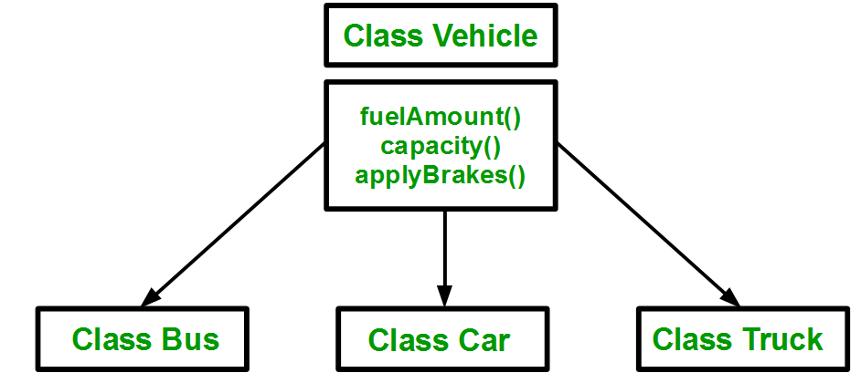
Using inheritance, we have to write the functions only one time instead of three times as we have inherited rest of the three classes from base class(Vehicle).

Slide 7
Inheritance is an is-a relationship. We use inheritance only if an is-a relationship is present between the two classes.
Here are some examples:
A car is a vehicle.
Orange is a fruit.
A surgeon is a doctor.
A dog is an animal.

Slide 8
Implementing inheritance in C++
class subclass_name : access_mode base_class_name
{
//body of subclass
};
Here, subclass_name is the name of the sub class, access_mode is the mode in which you want to inherit this sub class for example: public, private etc. and base_class_name is the name of the base class from which you want to inherit the sub class.
Note: A derived class doesn’t inherit access to private data members.

Slide 9
using namespace std;
//Base class
class Parent
{
public:
int id_p;
};
// Sub class inheriting from Base Class(Parent)
class Child : public Parent
{
public:
int id_c;
};
//main function
int main()
{
Child obj1;
// An object of class child has all data members
// and member functions of class parent
obj1.id_c = 7;
obj1.id_p = 91;
cout << "Child id is " << obj1.id_c << endl;
cout << "Parent id is " << obj1.id_p << endl;
return 0;
}
Child id is 7
Parent id is 91
In the above program the ‘Child’ class is publicly inherited from the ‘Parent’ class so the public data members of the class ‘Parent’ will also be inherited by the class ‘Child’.

Slide 10
Modes of Inheritance
Public mode: If we derive a sub class from a public base class. Then the public member of the base class will become public in the derived class and protected members of the base class will become protected in derived class.
Protected mode: If we derive a sub class from a Protected base class. Then both public member and protected members of the base class will become protected in derived class.
Private mode: If we derive a sub class from a Private base class. Then both public member and protected members of the base class will become Private in derived class.
The private members in the base class cannot be directly accessed in the derived class, while protected members can be directly accessed.

Slide 11
class A
{
public:
int x;
protected:
int y;
private:
int z;
};
class B : public A
{
// x is public
// y is protected
// z is not accessible from B
};
class C : protected A
{
// x is protected
// y is protected
// z is not accessible from C
};
class D : private A // 'private' is default for classes
{
// x is private
// y is private
// z is not accessible from D
};

Slide 12
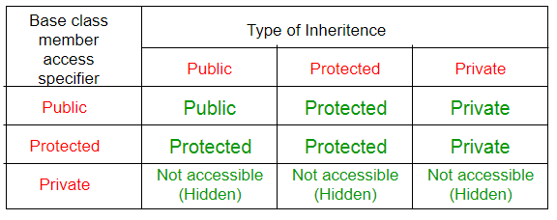

Slide 13
class Declaration
{
private:
int a;
public:
int b;
protected:
int c;
public:
void show()
{
a=10;
b=20;
c=30;
//Every members can be access here, same class
cout<<"\nAccessing variable within the class"<<endl;
cout<<"Value of a: "<<a<<endl;
cout<<"Value of b: "<<b<<endl;
cout<<"Value of c: "<<c<<endl;
}
};
class Sub_class:public Declaration
{
public:
}
void show()
{
b=5;
c=6;
cout<<"\nAccessing variable in sub the class"<<endl;
//cout<<"Value of a: "<<a<<endl;
//b is public so it is accessible any where
cout<<"Value of b: "<<b<<endl;
//'c' is declared as protected, so it is accessible in sub class
cout<<"Value of c: "<<c<<endl;
}
};
void main()
{
Declaration d; // create object
d.show();
Sub_class s; // create object
s.show(); // Sub class show() function
cout<<"\nAccessing variable outside the class"<<endl;
//'a' cannot be accessed as it is private
//cout<<"value of a: "<<d.a<<endl;
//'b' is public as can be accessed from any where
cout<<"value of b: "<<d.b<<endl;
//'c' is protected and cannot be accesed here
//cout<<"value of c: "<<d.c<<endl;

Slide 14
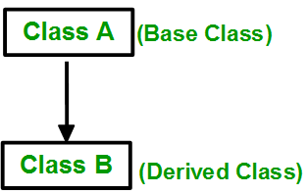
Single Inheritance

Slide 15
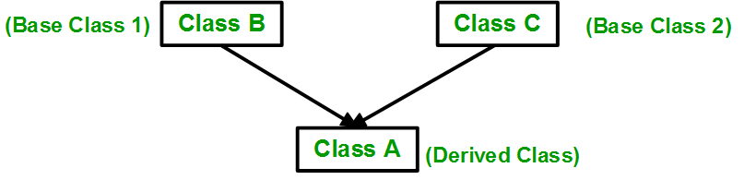
Multiple Inheritance:

Slide 16
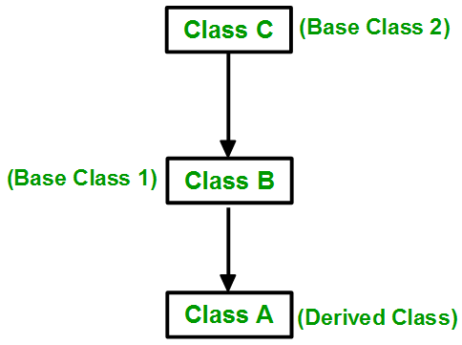
Multilevel Inheritance

Slide 17
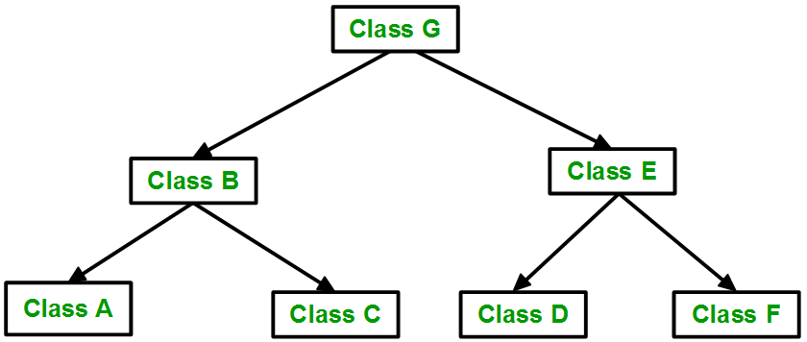
Hierarchical Inheritance:

Slide 18
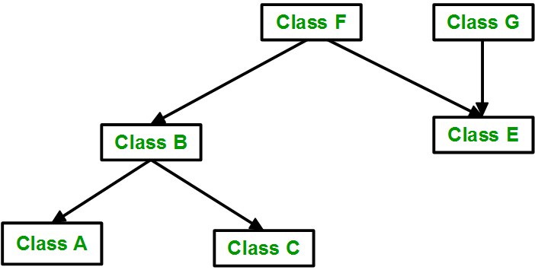
Hybrid (Virtual) Inheritance:

Slide 19
Multipath inheritance:

